Slide 1


Slide 2

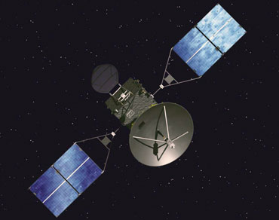
THAPAR UNIVERSITY
STUDENT SATELLITE
Initiative

Slide 3


CUBESAT-I, Stanford University
And many more many
Universities around the world.
POLYSAT, Calipoli, USA
ANUSAT, Anna University,
India

Slide 4
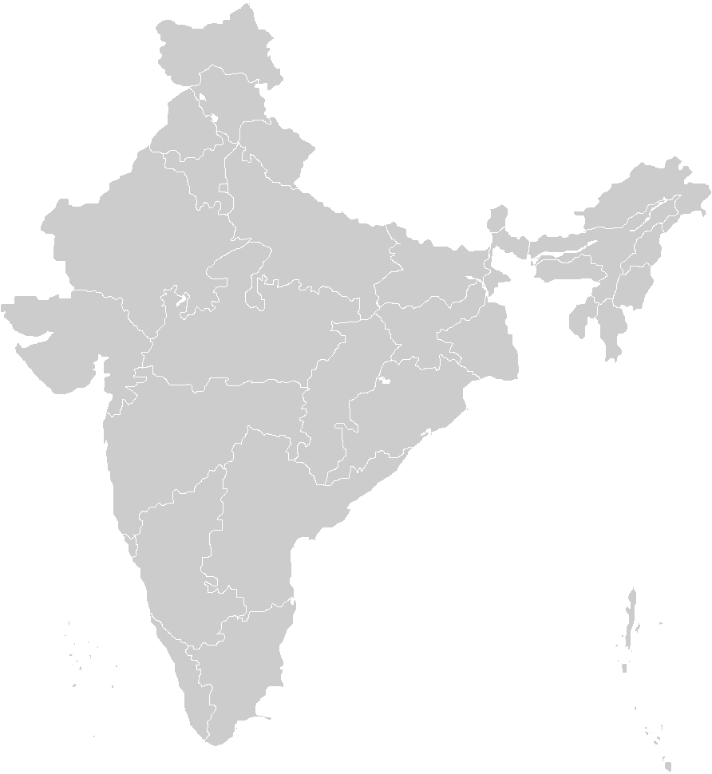

Indian Universities in fray
Jugnu, IIT Kanpur
Now it’s THAPAR’s Turn!!
Pratham, IIT Bombay

Slide 5

Objectives
Enable students and faculty to gain knowledge in Satellite and Space technology.
Enable students and faculty members to have hands-on experience with a real satellite mission.
Empower TUSSAT team with the skills to develop the Satellite through various phases of Design, Analysis, Fabrication and Testing until the Flight Model is made.

Slide 6

Technical Requirements
Exterior Dimensions: 100mm*100mm*300mm
Maximum Mass: 3.5 kg
Centre of gravity: To be located within 20mm of the geometric centre
Internal temperature: -10 Degree Celsius ~ 50 Degree Celsius for optimal electrical efficiency
.

Slide 7

Functional Features:
Capability to operate with full functionality for a minimum period of about 12 months.
Will receive command from the ground station uplink and be able to download various data packets.
Ability to store payload and status data when a link with the ground-station cannot be established.
It will not be powered during launch and have the ability to charge and power itself up after ejection from the launch vehicle.

Slide 8
Uncooled Microbolometer
Space Instrument Application

Slide 9
Microbolometer
A specific type of bolometer used as a detector in a thermal camera.
Infrared Radiation with wavelngths between 8-13um strikes the detector material, heating it and thus changing the electrical resistance.
The resistance change can changed into temperatures which can be used to create an image.

Slide 10
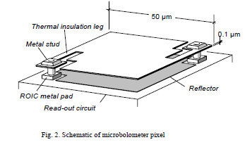
Basic Principle and Construction
A bolometer is a device for measuring the energy of incident radiation.
A microbolometer is an uncooled thermal sensor which does not require expensive cooling methods like stirling cycle coolers and liquid nitrogen coolers.
It consists of an array of pixels-each made up of several layers.

Slide 11
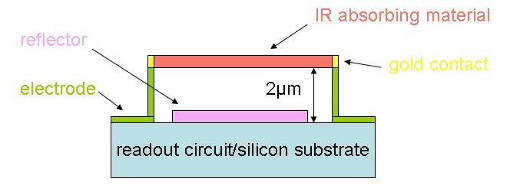
Each pixel is made up of several layers.
The bottom-most layer consists of a ROIC and Si-substrate.
A reflector is created beneath the IR absorbing material to ensure greatest possible absorption.
A sacrificial layer is deposited so that later a gap can be created to separate IR absorbing material and the ROIC.
A layer of absorbing material is then deposited and selectively etched so that final contacts can be created.
A bridge like structure is created by removing the sacrificial layer.

Slide 12
Resistive bolometer is the most commonly used detection mechanism. Its resistance changes with temperature.
The ROIC is so designed as to measure the resistance of each pixel and then format the results into a single data stream for imaging purposes.
Thermal insulation is essential high sensitivity. So, Uncooled IR detectors are operated under vacuum.

Slide 13
Advantages
There is no need to cool the detectors, which reduces size and complexity of the sensor.
Light in 8 μm to 13 μm spectral band. This spectral band provides a better penetration through smoke, smog, dust, water vapor etc. because the wavelength is much longer than visible light in the 0.4 to 0.7 μm spectral band.
It takes a snapshot image rather than using any in line techniques which increses it’s accuracy.
It is very light in weight and uses very low power and so can be used on a nano satellite.

Slide 14
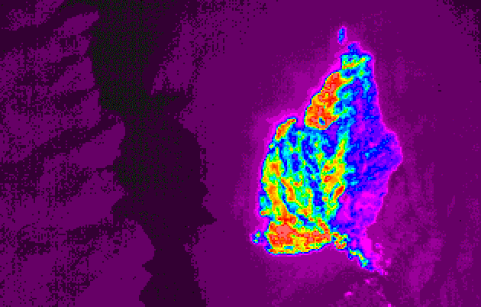
A Sample Image
A sample image obtained by a Microbolometer

Slide 15
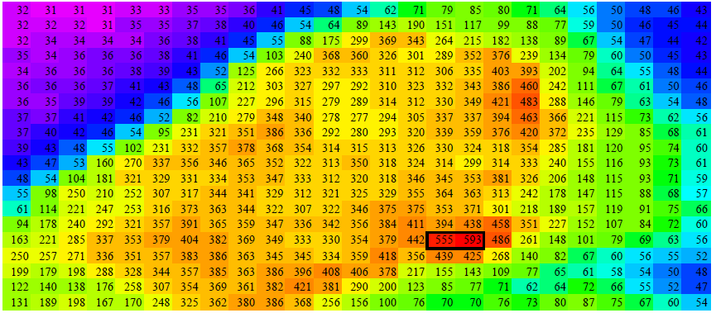
Calibration Data

Slide 16
Some Salient Features
FSI currently uses NASA MODIS which is a system designed basically for clouds and saturates in small fires.
We are working for a system designed specifically for forest fires
We can go for 640 X 480 with a spatial resolution of about 1 km or 320 X 240 with a spatial resolution of about 2km
Images will be updated on a daily basis.
We are at present concentrating on INDIA only but we can cover some other areas also.

Slide 17
Supporting Institution
Government of Germany – German Embassy in India
TERI
IIT Bombay

Slide 18
Budget
Satellite Development Cost : INR 35 Lacs
Payload Cost : INR 25 Lacs
Total Cost : 60 Lacs

Slide 19
THANK YOU

